Slide 1

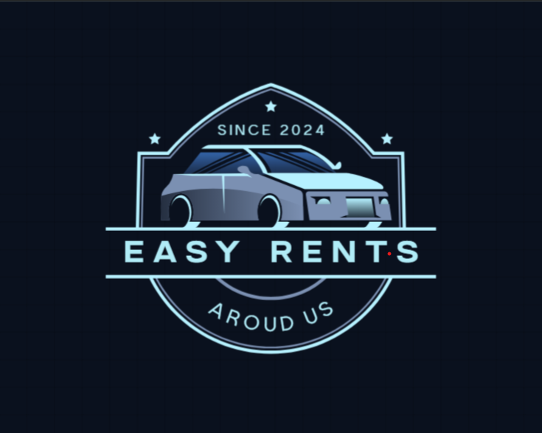
Welcome to Easy Rents
Your one-stop destination for Searching and Renting Vehicles around you.

Slide 2


EASY RENTS
Guided By:
Mrs. Bakul
Joshi
Group Members:-
Atharva Kalokhe 240343020020
Shubham khedekar 240343020096
Saurav Dutal 240343020091
Manish Rathod 240343020055

Slide 3
TABLE OF CONTENTS
Introduction To Easy Rents
Problem Statement
Overview
Customer Interface
Owner interface
Admin Interface
System Architecture:
Conclusion
Future Scope
01
02
03
04
05
06
07
08

Slide 4
Introduction to Easy Rents
What is Bike And Car Rental portal :
A web-based application designed to revolutionized Rental platform connecting customers directly with vehicle owners.
Main Goal:
The main objective of the Bike and Car Rental System Portal is to provide a platform where customers can rent bikes or cars, and owners can list their vehicles for rent, with an administrative module to manage accounts and transactions.

Slide 5

Problem Statement
There isn't a single, affordable system for renting bikes and cars.
People who want to rent vehicles often deal with scattered services, unclear pricing, and limited information about availability.
Traditional rental methods involve several middlemen, which can increase costs and make the process more complicated.
This results in inefficiencies and unhappy customers.
The proposed system aims to simplify and centralize the process, offering a clear and easy-to-use platform where users can quickly find, book, and rent vehicles.

Slide 6
Overview Of Easy Rents
Key Features:
Vehicle Listing- Allows Vehicle owners to list their vehicles for renting.
Search Functionality: Enables wholesalers to find products based on specific criteria
Transaction Management: Facilitates buying and selling processes
Customer Module
Owner Modules: Vehicle owner Module
Admin Module (for system management)
Easy Rental Solutions:
Easy Vehicle Booking process
Ability to Search Vehicles at Lowest cost.
Customer Features:
Search options for finding Vehicles
Book Vehicles

Slide 7
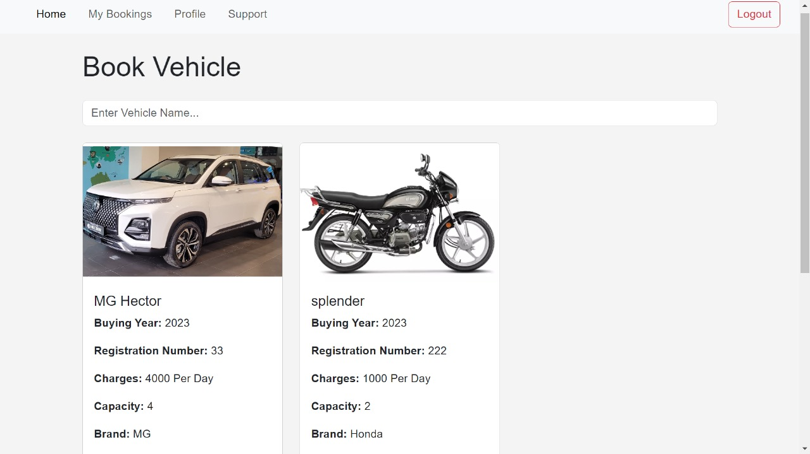
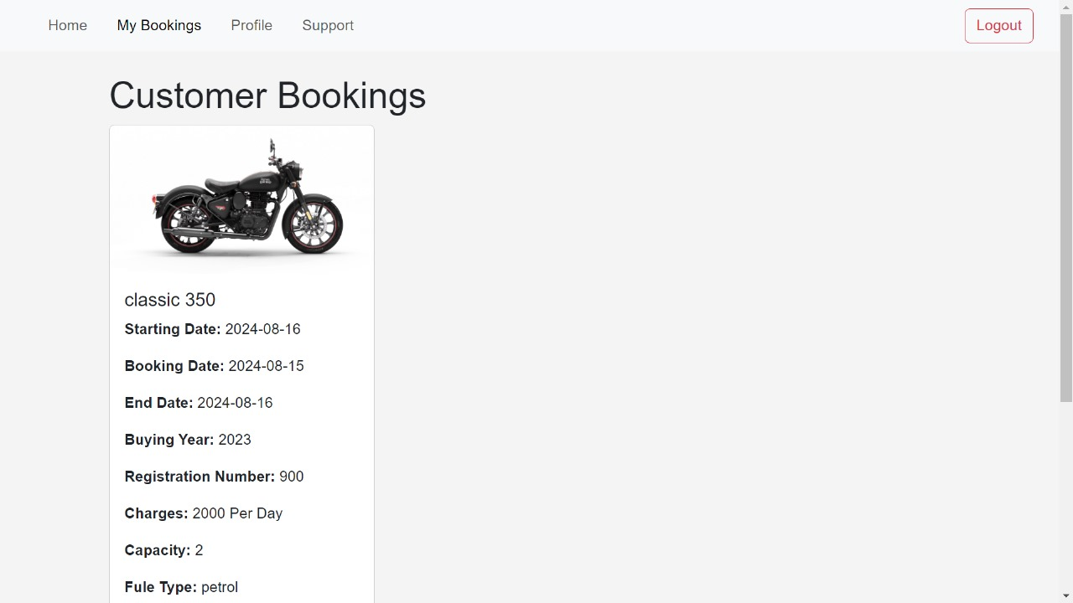
Customer User Interface
Searching and Renting of Vehicles
Key activities:
Creating and managing accounts
Searching for Vehicles.
Renting Vehicles from Vehicle Owners.
Managing Bookings and transactions
Viewing market prices for comparing.

Slide 8
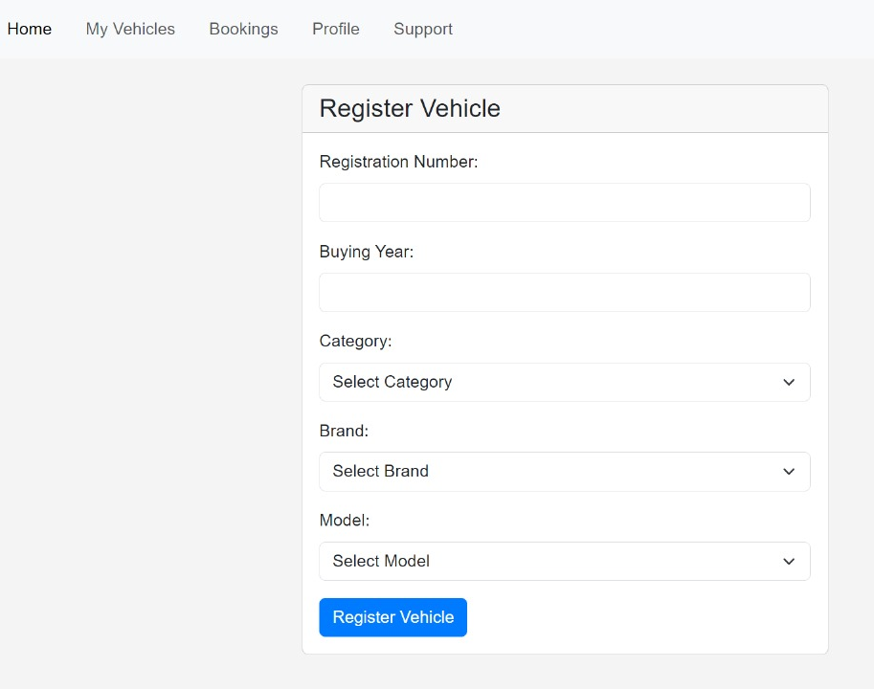
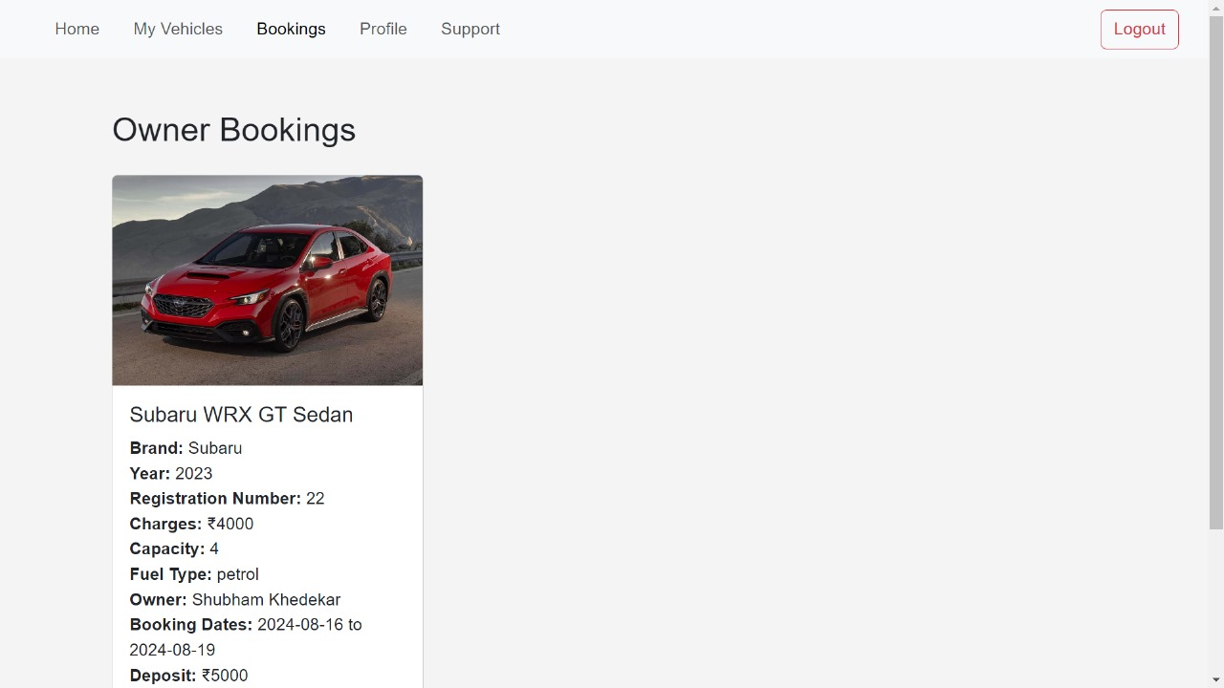
Vehicle Owner User Interface
Owners: Uploading and Giving Vehicles on temporary basis on this platform.
Key activities:
Creating and managing accounts
Listing Vehicles for sale
Updating Vehicle information

Slide 9
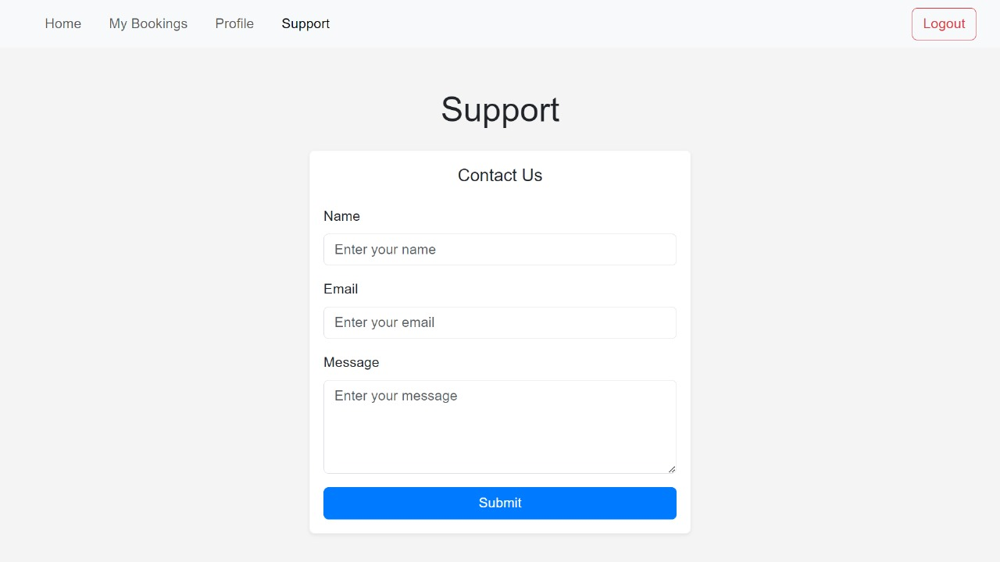
Admin User Interface
Admin : System administrators responsible for platform management
Key responsibilities:
Managing user accounts
Overseeing transactions
Generating reports
Ensuring system integrity and security

Slide 10
System Architecture:
Frontend (User Interface):
React.js: The frontend is built using React.js, providing a responsive and user-friendly interface for both Customers and Owners. It allows users to interact with the platform, view product listings, manage accounts, and perform transactions.
User Roles:
Vehicle Owner Dashboard: Interface for owners to list vehicles and manage transactions.
Customer Dashboard: Interface for customers to browse vehicles, rent vehicles, and do transactions.

Slide 11
System Architecture:
Backend:
.NET Core: Handles user authentication and registration. It provides secure login functionality and manages user sessions.
•Spring Boot: Manages the core functionalities of renting and searching, including vehicle management, order processing, and transaction handling.
•Database:
•MySQL: A relational database stores user information, vehicle listings, transaction histories, and other critical data. The database is structured to ensure efficient data retrieval and storage.
•APIs:
•RESTful APIs: Enable communication between the frontend and backend. They handle requests for data retrieval, user actions, and other interactions between the different modules.

Slide 12
Conclusion:
Helping Tourists and Customers: Easy Rents connect customers directly with vehicle owners, improving access to market information and facilitating better deals.
Fair Pricing: Eliminates middlemen to ensure fair pricing for customers and consistent supply for Vehicles.
Empowering Vehicle Owners: Uploading Vehicles and giving them on Rent on temporary basis , it can create a new income source for middle class peoples.

Slide 13
Future Scope:
Guides to integrate personalized Renting information.
Customer will be able to get details of vehicles according to date, time and by type.
Support section will help Customers to upload questions and others can help .
Vehicle owners will get notified about who rented his vehicles and maintain history.

Slide 14
THANK
YOU !!

